Slide 1
Data Structure with STL
By:Mohamed Essam

Slide 2

Data Structures
Every child knows that one can – at least beyond a certain number – find things much easier if one keeps order. We humans understand by keeping things in order that we separate the things that we possess into categories and assign fixed locations to these categories that we can remember.
We may simply throw socks into a drawer, but for other things like DVDs it is best to sort them beyond a certain number so that we can quickly find every DVD.

Slide 3
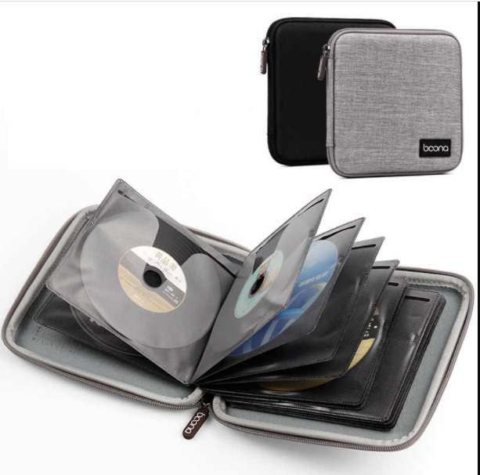
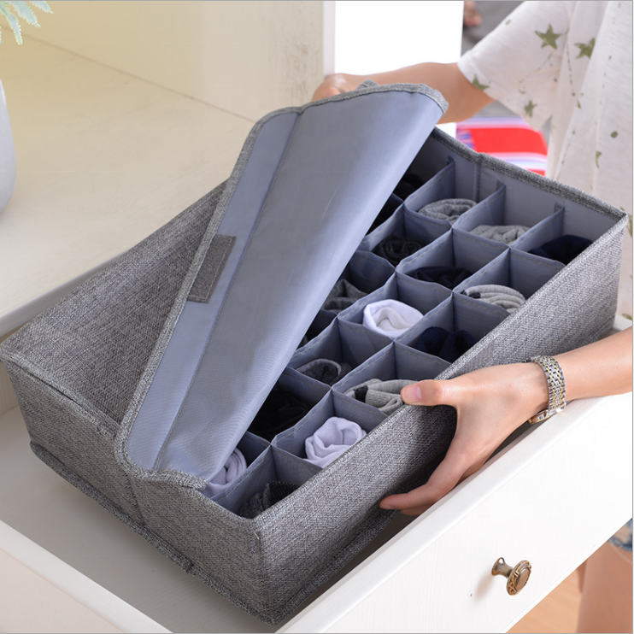

Slide 4
C++ STL
STL stands for Standard Template Library. Alexander Stepanov invented it in 1994, and later it was included in the standard library. The standard library consists of a set of algorithms and data structures that were originally part of the C++ Standard template library.
STL helps in storing and manipulating objects, and it makes the program reusable and robust.

Slide 5
CONTAINERS
Suppose you are at your favorite cinema hall and it's the launch of a big movie. Since it's the launch, there are likely many people waiting in line to buy their tickets. Naturally, you join the queue at the back and wait for your turn. In the computing world, we have a queue too! This is a popular data structure. If you've had a Data Structures class before, you are most likely familiar with some other data structures as well. These are often used, so the STL provides a great implementation of all these data structures, otherwise known as containers.

Slide 6
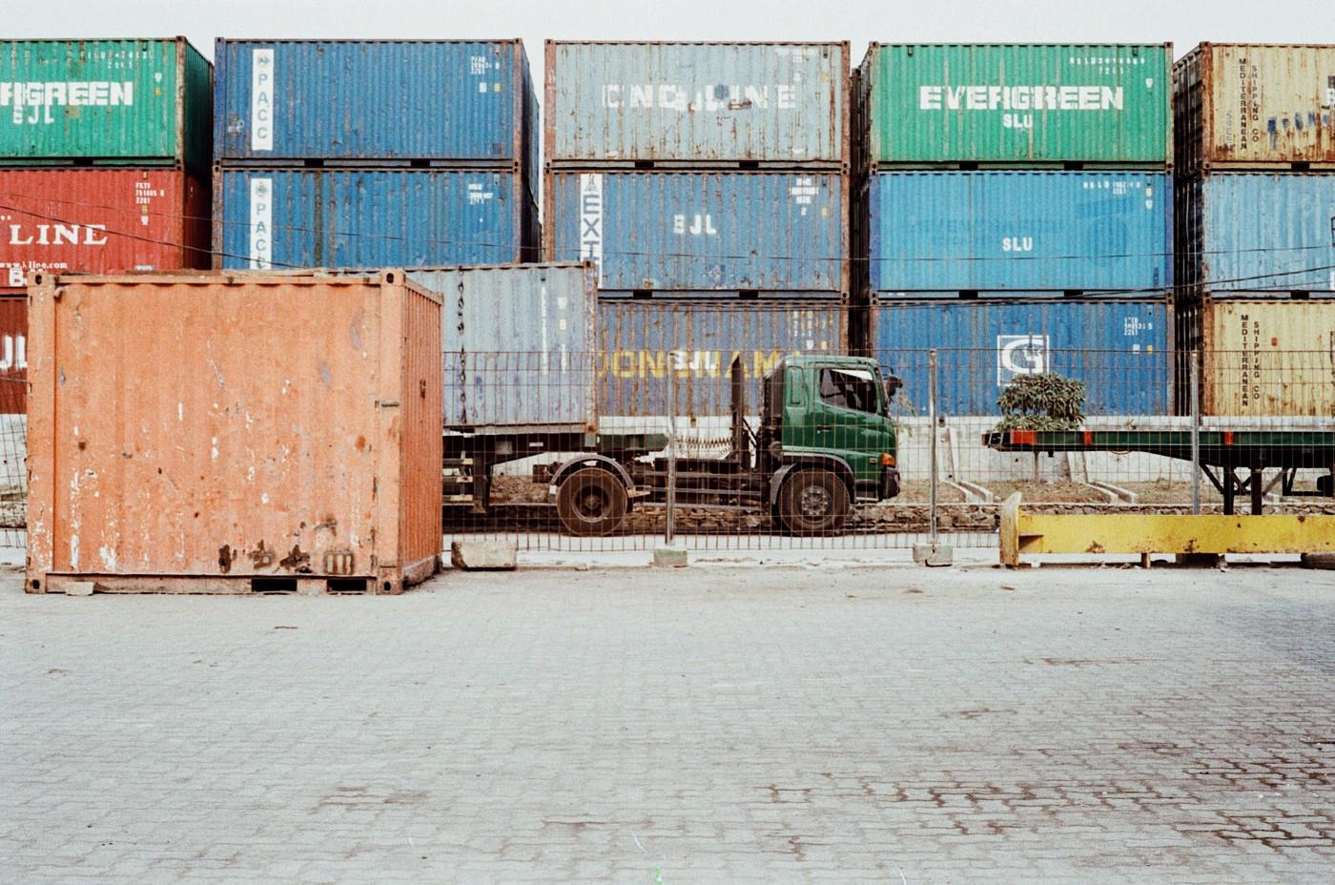
CONTAINERS
Suppose you are at your favorite cinema hall and it's the launch of a big movie. Since it's the launch, there are likely many people waiting in line to buy their tickets. Naturally, you join the queue at the back and wait for your turn. In the computing world, we have a queue too! This is a popular data structure. If you've had a Data Structures class before, you are most likely familiar with some other data structures as well. These are often used, so the STL provides a great implementation of all these data structures, otherwise known as containers.

Slide 7
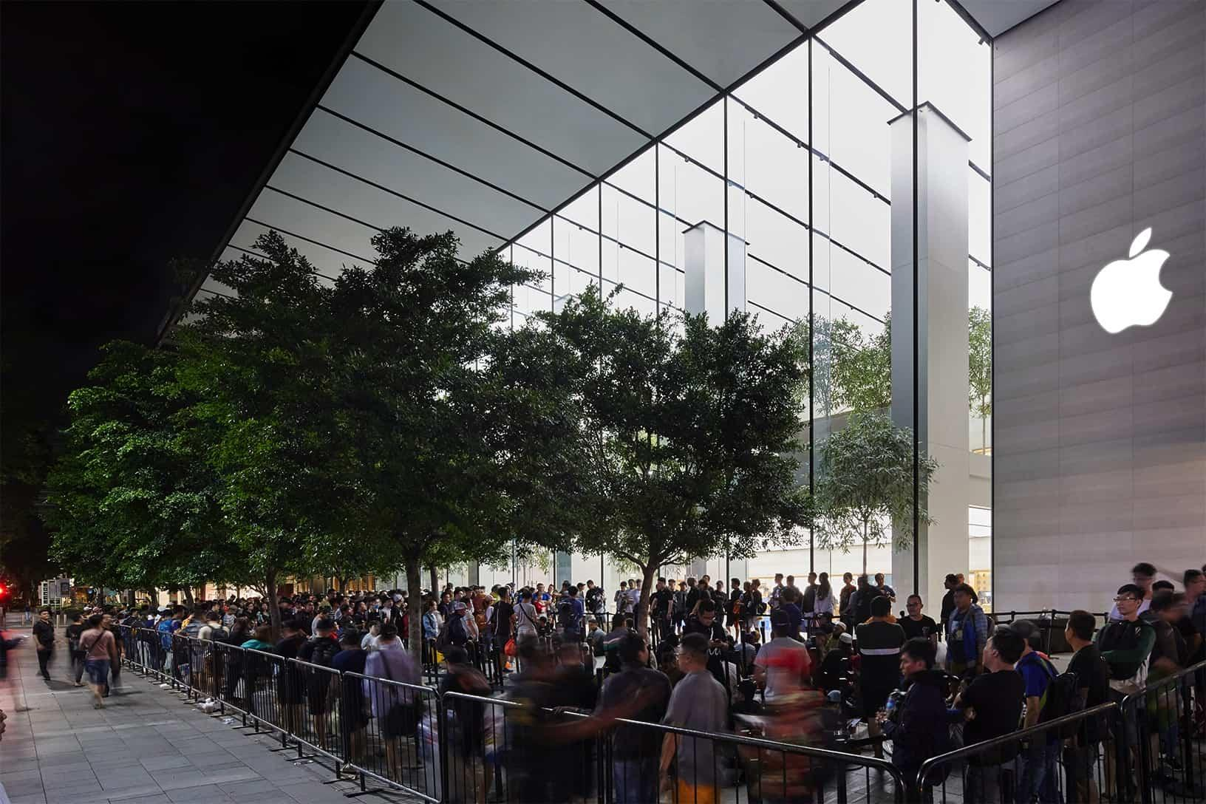
CONTAINERS
Suppose you are at your favorite cinema hall and it's the launch of a big movie. Since it's the launch, there are likely many people waiting in line to buy their tickets. Naturally, you join the queue at the back and wait for your turn. In the computing world, we have a queue too! This is a popular data structure. If you've had a Data Structures class before, you are most likely familiar with some other data structures as well. These are often used, so the STL provides a great implementation of all these data structures, otherwise known as containers.

Slide 8

C++ STL
STL stands for Standard Template Library. Alexander Stepanov invented it in 1994, and later it was included in the standard library. The standard library consists of a set of algorithms and data structures that were originally part of the C++ Standard template library.
STL helps in storing and manipulating objects, and it makes the program reusable and robust.

Slide 9
Elements of the STL
Containers
Collections of objects or primitive types
[Array, vector, deque, stack, set, map, etc]
Algorithms
Functions for processing sequences of elements from containers
[find, max, count, accumulate, sort, etc]
Iterators
Generate sequence of element from containers
[forward, reverse, by value, by reference, constant, etc.]

Slide 10
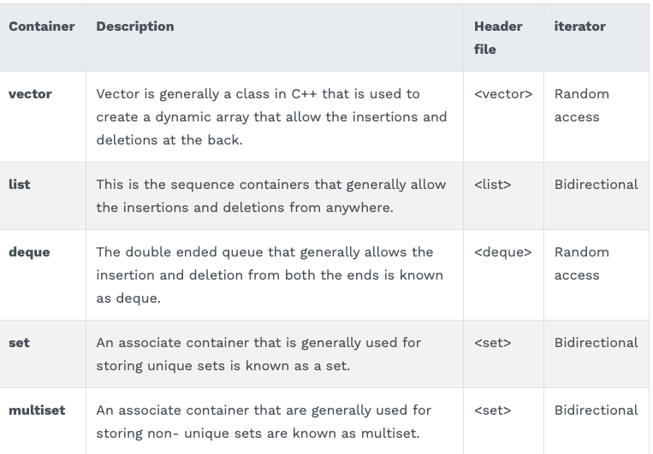
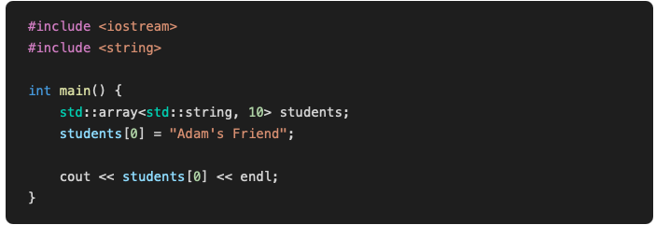
CONTAINERS-ARRAYS
But wait, STL provides a container for arrays too. It's available in the header <array>. Example usage of it would look like this:

Slide 11
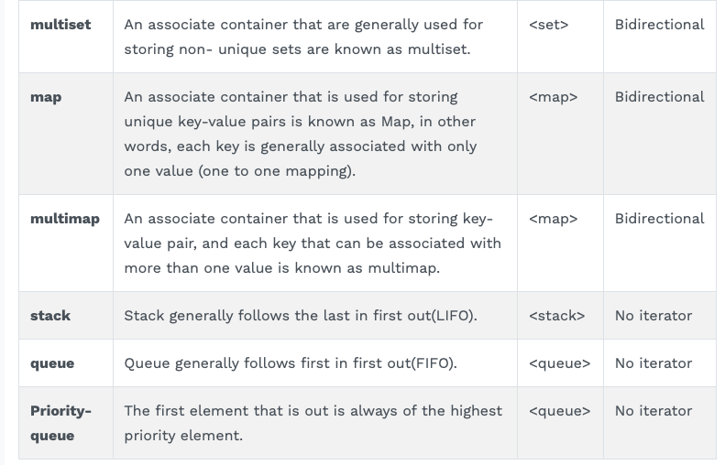
CONTAINERS-ARRAYS
But wait, STL provides a container for arrays too. It's available in the header <array>. Example usage of it would look like this:

Slide 12

CONTAINERS
Take arrays, for example. Arrays are elements with the same type, stored in contiguous blocks of memory. In C++, you can use arrays as you would in C, like this:

Slide 13
CONTAINERS-ARRAYS
Take arrays, for example. Arrays are elements with the same type, stored in contiguous blocks of memory. In C++, you can use arrays as you would in C, like this:

Slide 14
CONTAINERS-ARRAYS
But wait, STL provides a container for arrays too. It's available in the header <array>. Example usage of it would look like this:

Slide 15
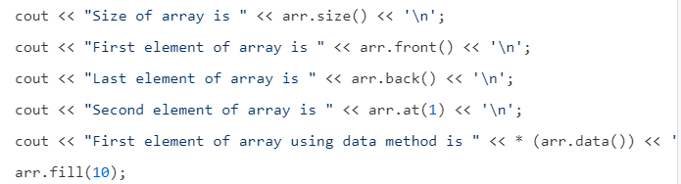
CONTAINERS-ARRAYS
But wait, STL provides a container for arrays too. It's available in the header <array>. Example usage of it would look like this:

Slide 16
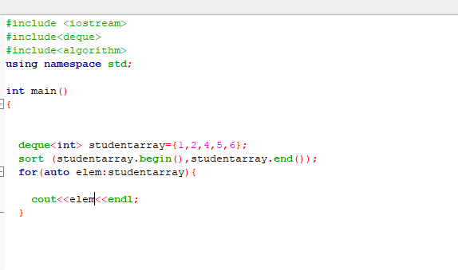
CONTAINERS-ARRAYS

Slide 17
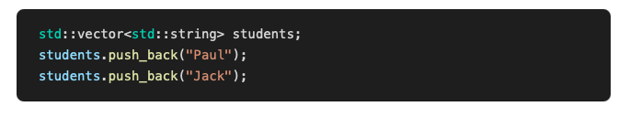
CONTAINERS-VECTORS
Vector: Dynamically resizable arrays. Arrays have a set size, while std::vector doesn't. You can keep adding elements in contigious blocks of memory. For example:

Slide 18
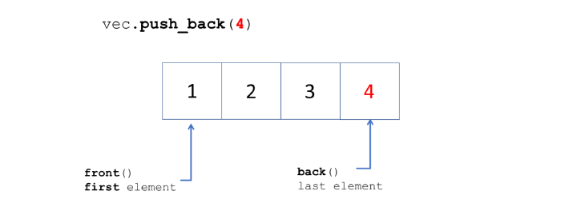
CONTAINERS-VECTORS
Vector: Dynamically resizable arrays. Arrays have a set size, while std::vector doesn't. You can keep adding elements in contigious blocks of memory. For example:

Slide 19
CONTAINERS-VECTORS
Vectors are the same as dynamic arrays with the ability to resize itself automatically when an element is inserted or deleted, with their storage being handled automatically by the container. Vector elements are placed in contiguous storage so that they can be accessed and traversed using iterators. In vectors, data is inserted at the end. Inserting at the end takes differential time, as sometimes the array may need to be extended. Removing the last element takes only constant time because no resizing happens. Inserting and erasing at the beginning or in the middle is linear in time.

Slide 20
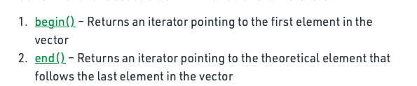
CONTAINERS-VECTORS

Slide 21
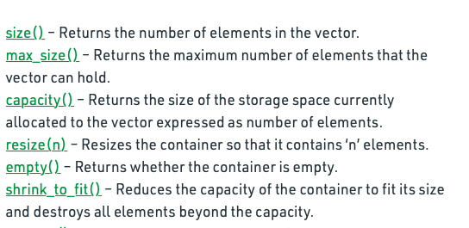
CONTAINERS-VECTORS

Slide 22
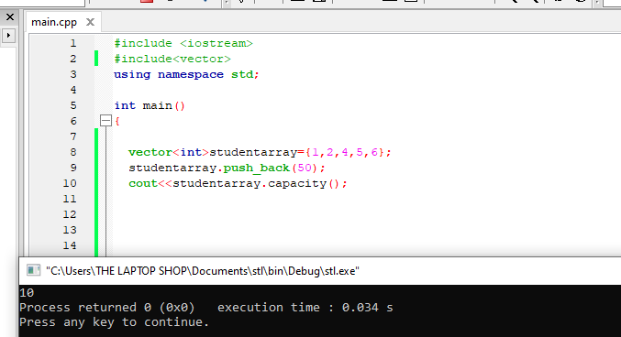
CONTAINERS-VECTORS

Slide 23
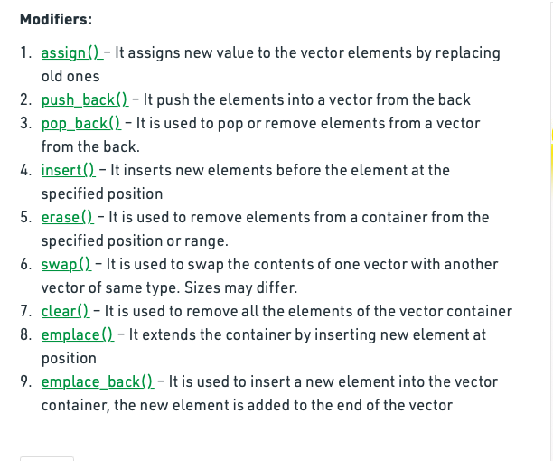
CONTAINERS-VECTORS

Slide 24
CONTAINERS-DEQUE
Deque in C++ is an abbreviation that generally stands for double ended queue. The queue data structure is generalised by the Deque and that basically means the insertion and deletion can be executed from both the ends that can be either front or back.

Slide 25
Thank you

